Slide 1
Omics datasets and analysis

Slide 2
Sergio Rodriguez Llana (GSE6297)
Title: Expression data from livers of mice fed four different diets
Response variable: gene expression
Sources of variation:
Treatment (Factors) -> Diets: Chimpanzee, FastFood, HumanCafe, Pellet
2 Groups: Batch: (2 for every Diet),
Number of experimental units per each combination of factors: 3
Sample size: 24 samples
Experimental design: Factorial Design (bause all the mouse individuals were genetically equal: 8-week-old female NMR1 mice).

Slide 3
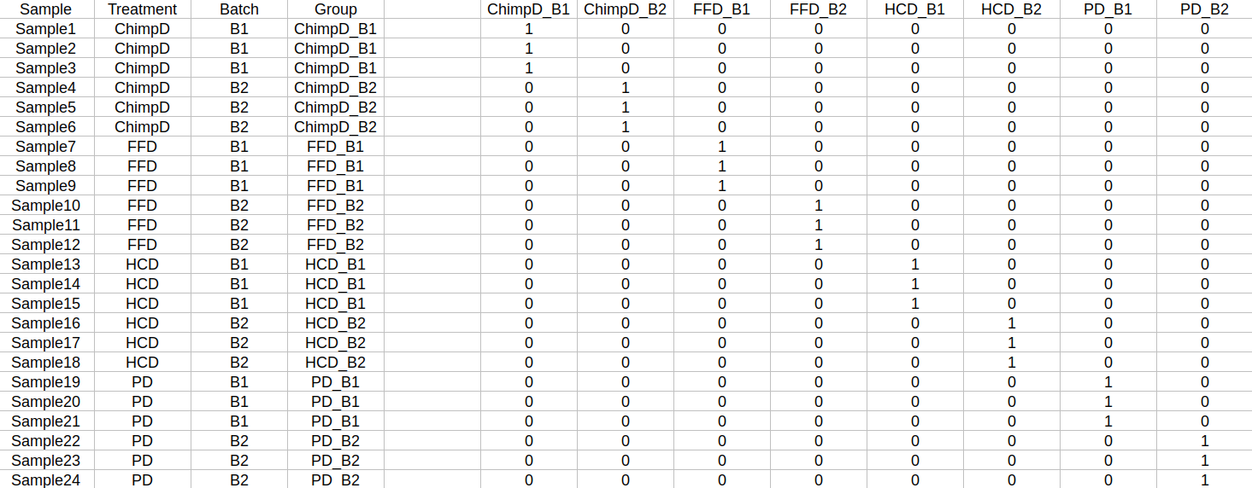
Sergio Rodriguez Llana (GSE6297) - Linar model

